Slide 1
Food Recipe Suggestion
Prepared by:
Dhaval Khunt(18DIT027)

Slide 2
Problem Statement
To find which recipe we can make from available ingredients with us and give YouTube video link for particular recipe.

Slide 3
Introduction
Sometime we are in tremendous confusion about making delicious food from the ingredients which we are available . So, we come up with this solution.
We take list of ingredients as input then check for the recipe in the dataset When we found recipe then search for YouTube link for that recipe and display all the things.

Slide 4
Requirements
Python 3
Ulib library

Slide 5
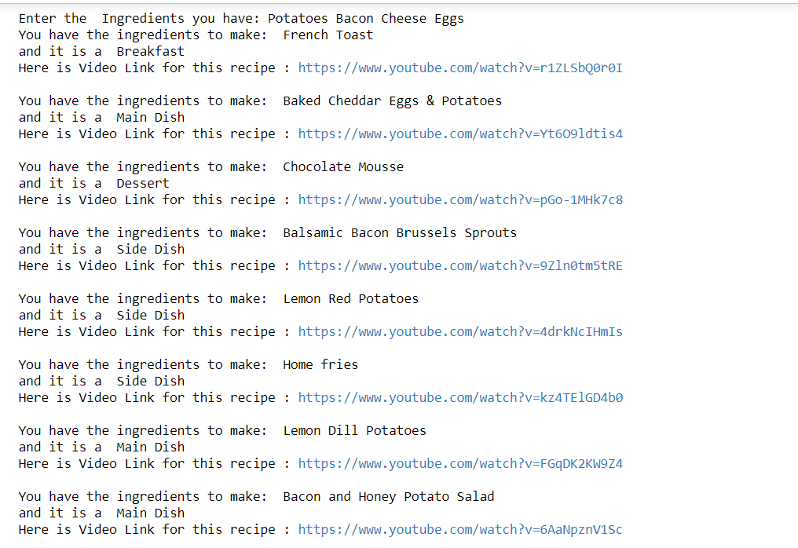
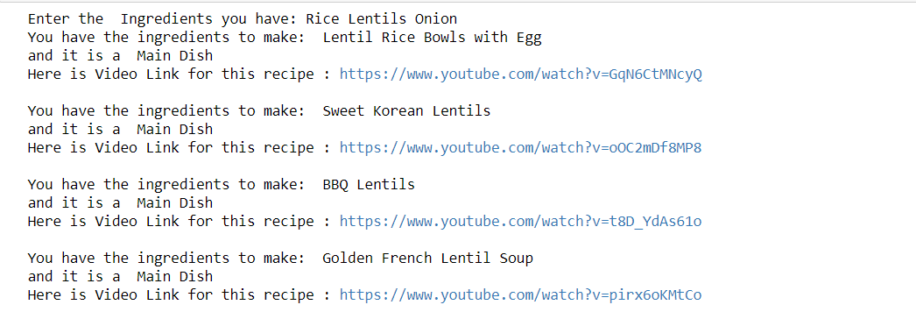
Implementation Snapshots

Slide 6
Conclusion
In this project, I have learned basic concepts of python.
Also, I have learned to create .txt file and read that file and search in that file and create dictionary of that.
I have also learned how to use ulib Library.

Slide 7
Reference
https://www.python.org/downloads/
https://pypi.org/project/ulib/
https://www.youtube.com/ for data

Slide 8
Thank You

